Slide 1


Slide 2
The cloud?
"The cloud" is one of those trendy tech terms a lot of people use but can't clearly define. What is the cloud? When do you encounter it? How can it benefit your business?
If you use any kind of social media or online data drive, you're already using the cloud; you just may not realize it.

Slide 3
What is the cloud exactly?
The first thing you should understand about the cloud is that it is not a physical thing. The cloud is a network of servers, and each server has a different function. Some servers use computing power to run applications or "deliver a service. "If you use any kind of social media or online data drive, you're already using the cloud; you just may not realize it.

Slide 4
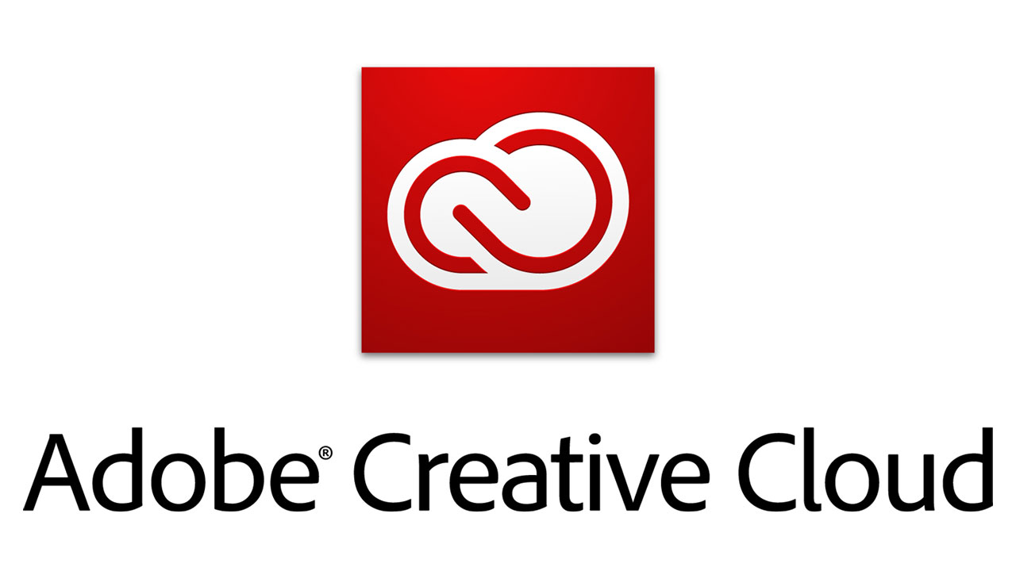
For example, Adobe recently moved its creative services to the cloud. You can no longer buy the Creative Suite (Photoshop, InDesign, etc.) in a box set. Instead, you must pay a monthly subscription fee to use each individual service. That's why it's now called the "Adobe Creative Cloud" instead.

Slide 5
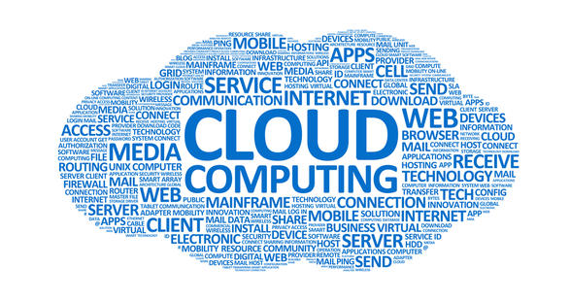
Other servers in the network are responsible for storing data. For example, when you take a picture on your smartphone, it is stored on your phone's internal memory drive. However, when you upload the photos to Instagram, you are uploading it to the cloud.

Slide 6
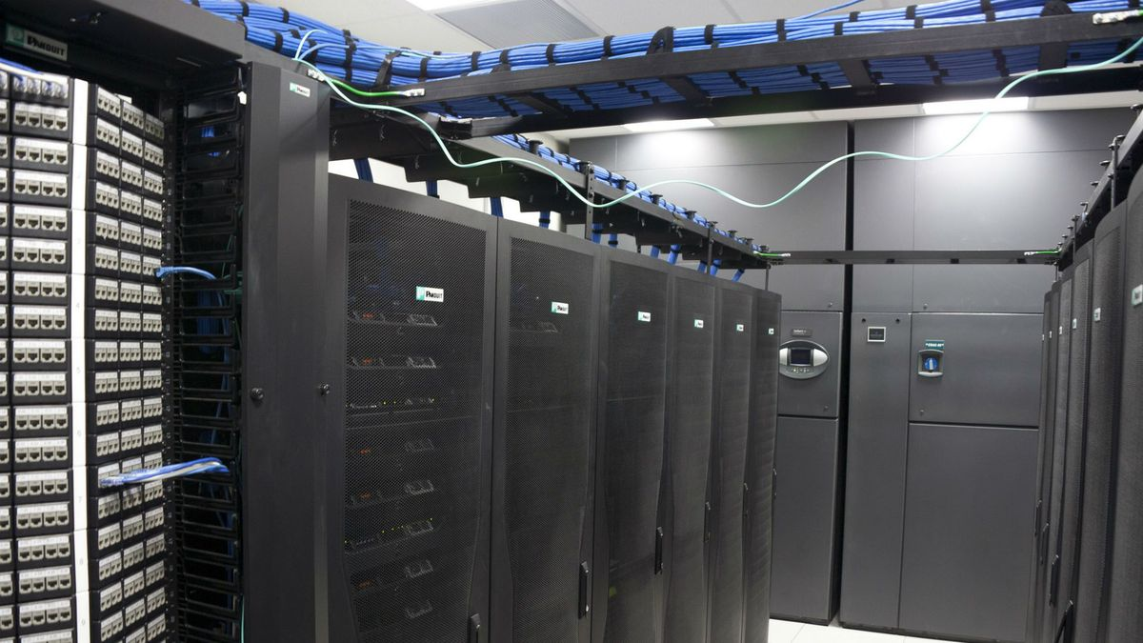
"The Cloud" is a network of servers. Some servers provide an online service, like Adobe Creative Cloud, and others allow you to store and access data, like Instagram or Dropbox.
Chances are, you encounter the cloud daily. From Google Drive to SkyDrive to iCloud to Evernote, any time you store information without using up your phone's internal data, you're storing information on the cloud.

Slide 7
What are the benefits to working in a cloud?
The business decision to "move to the cloud" is often financially motivated. Companies used to have to buy their own hardware equipment, the value of which depreciated over time. But now with the cloud, companies only have to pay for what they use. This model makes it easy to quickly scale use up or down.
That's why the cloud is such a big deal; it doesn't just let you upload that delicious looking #foodporn (although that is important), but it also helps companies save thousands of dollars a year.

Slide 8
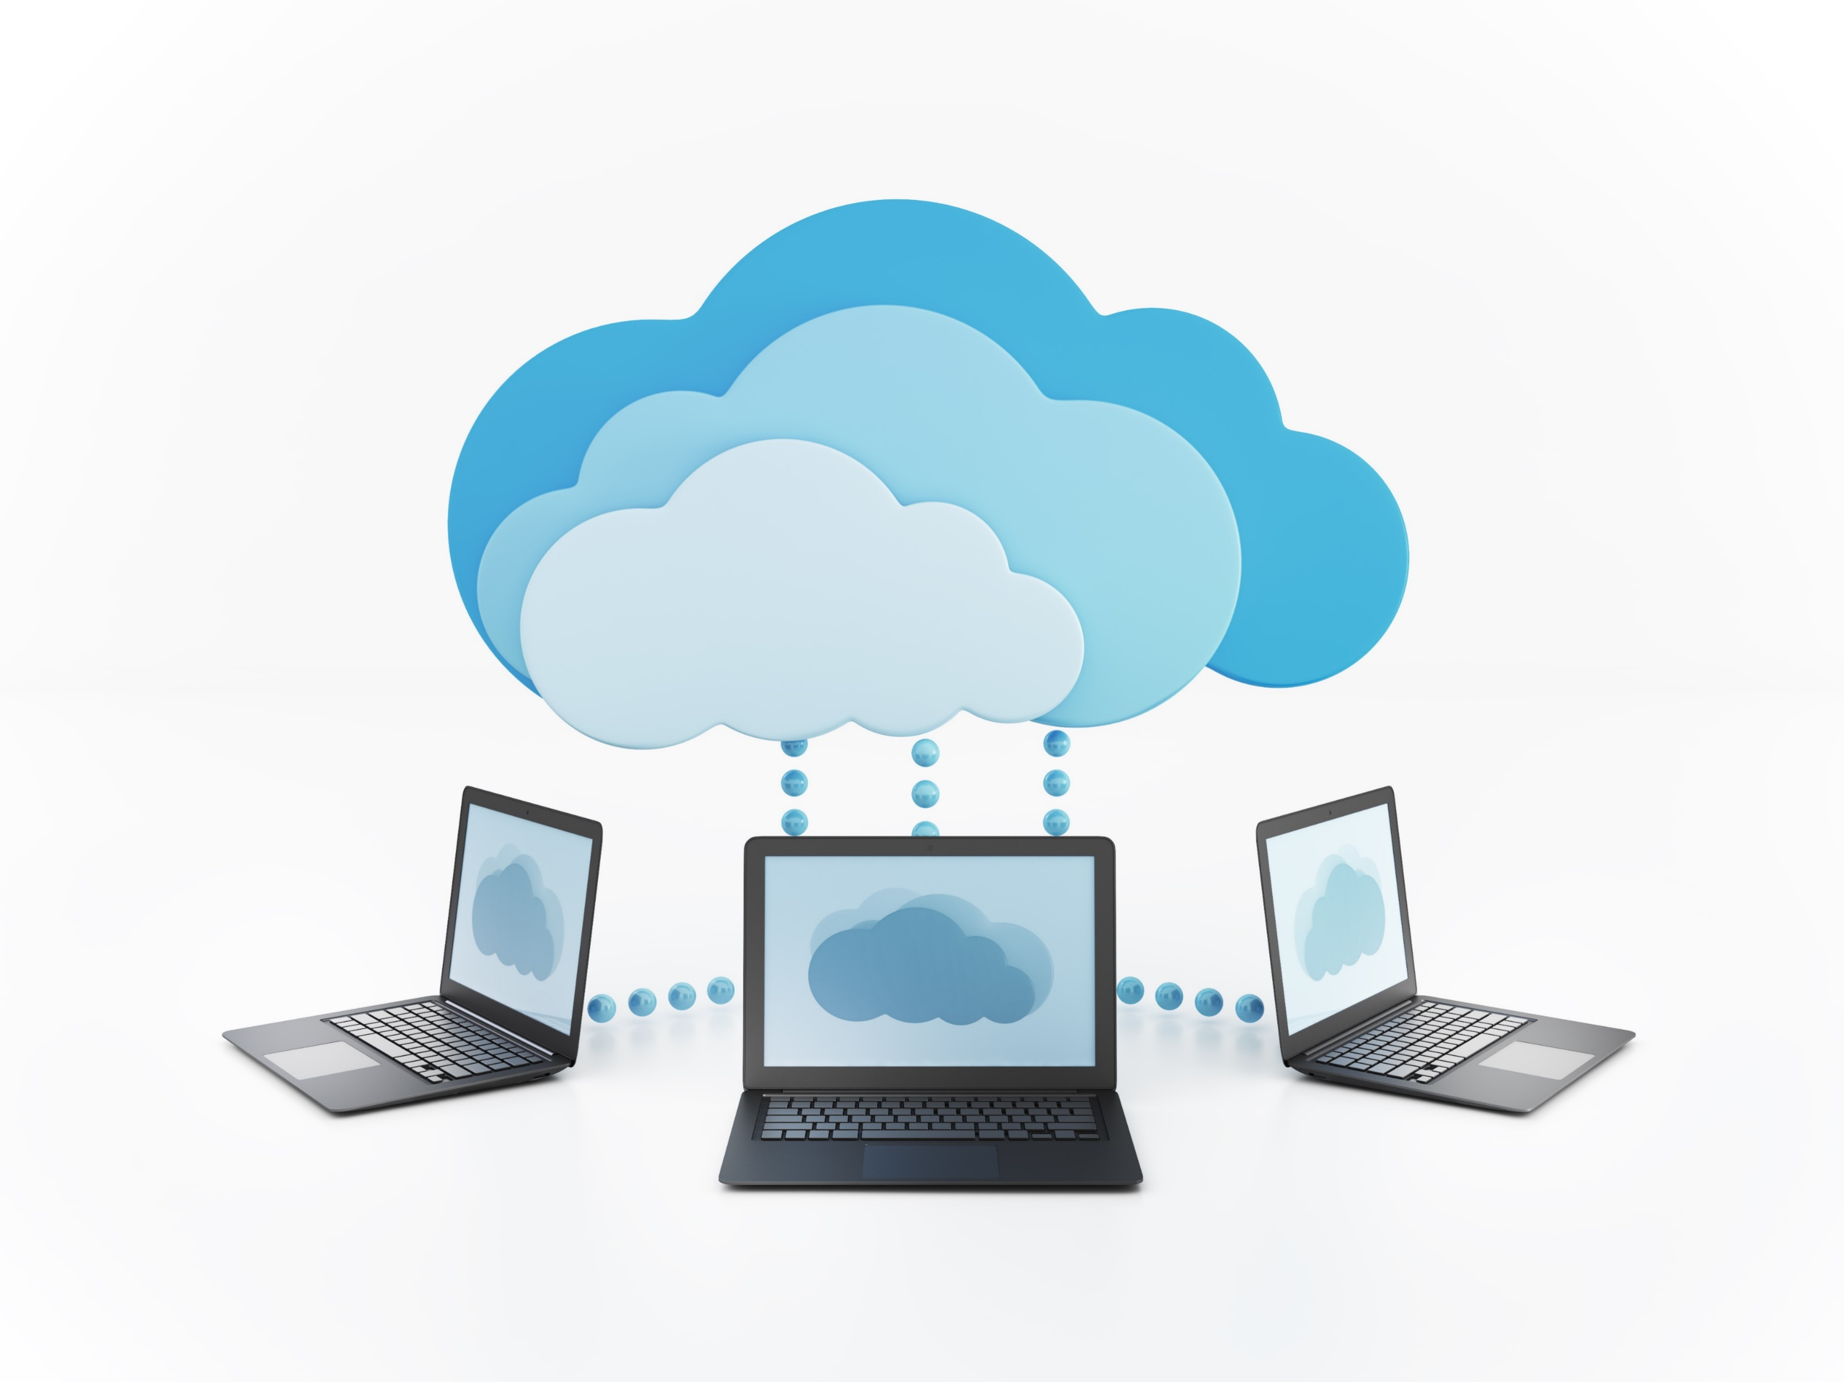
In an article on the benefits of cloud computing, SalesForce wrote, "Where in the past, people would run applications or programs from software downloaded on a physical computer or server in their building, cloud computing allows people access the same kinds of applications through the Internet.“

Slide 9

Working on the cloud allows your company to be nimble, efficient and cost-effective. If your company quickly needs access to more resources, it can scale quickly in the cloud. Conversely, if it needs to downscale or reduce resources, it can do so just as easily. Because of this scalability, the cloud's elasticity is often compared to that of a rubber band.

Slide 10
A brief history of the cloud
The history of the cloud dates back as far as the 1950s. Back then, a mainframe (read: computer) was so big it took up an entire room. Because mainframes were so expensive, organizations couldn't afford to purchase a new one for each user. In response, they developed "time sharing" methods, which let multiple users share access to data and CPU time.

Slide 11
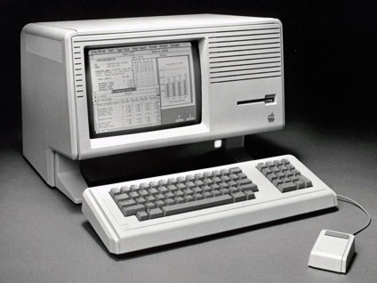
Today, this idea of "time sharing" is the premise of cloud computing. The next major event in cloud computing history occurred in 1969, when J.C.R. Licklider developed ARPANET (Advanced Research Projects Agency Network) in hopes that some day everyone would be able to access data and programs from any location.
Professor Ramnath Chellappa was the first to use the term "cloud computing" in 1997, and in 1999, Salesforce became the first site to deliver applications and software over the Internet.

Slide 12
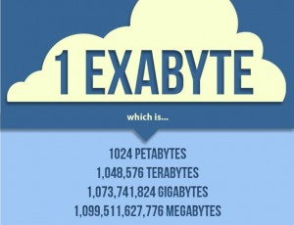
How big is the cloud?
No one knows exactly how much space can be provided by cloud-based services like Google, Amazon or Facebook; however, according to this infographic, the cloud can store about 1 Exabyte.
How big is an Exabyte? An Exabyte of memory can hold the same amount of data as 4.2 million Macbook Pro hard drives. That's a lot of storage.

Slide 13
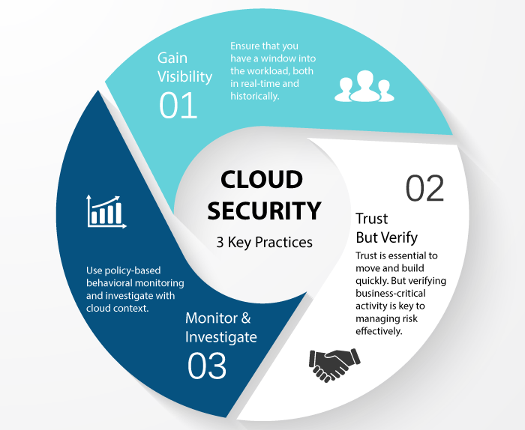
How secure is the cloud?
The cloud is great for storing non-sensitive information, like to-do lists on platforms like Evernote. But unsurprisingly, the idea of storing personal information somewhere "up in the cloud" makes many people wary.
Some companies, like Google, are responding to this worry accordingly. Google recently announced it would automatically encrypt data for paid cloud storage service users.

Slide 14
Sources
Mashable – The Beginnner’s Guide to the Cloud
Wikipedia - https://en.wikipedia.org/wiki/Cloud_computing
Skillpipe – Developing Microsoft Azure Solutions (20532C)

